Slide 1

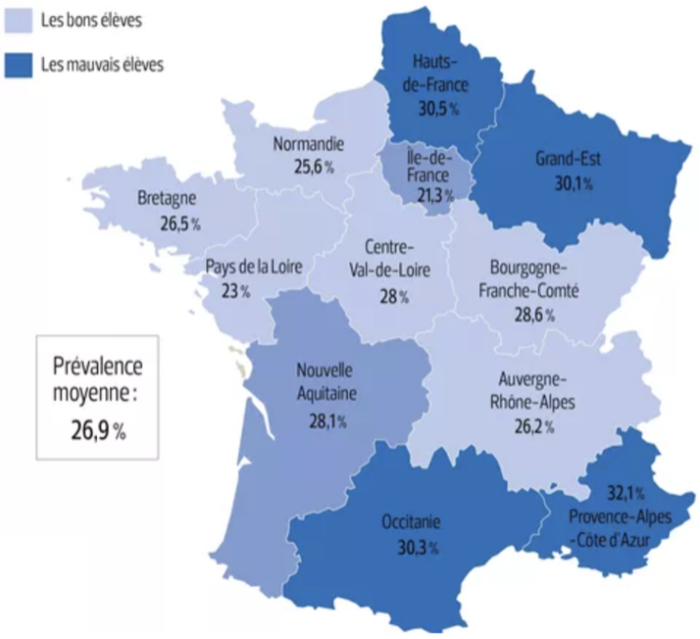
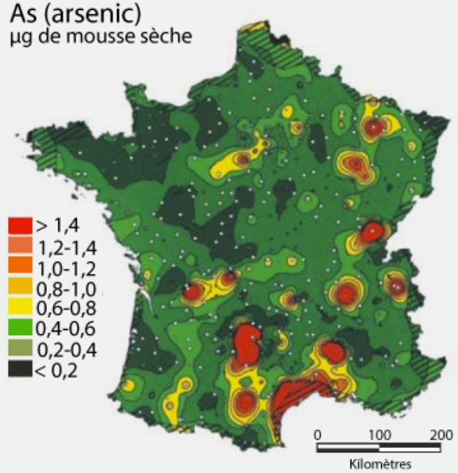
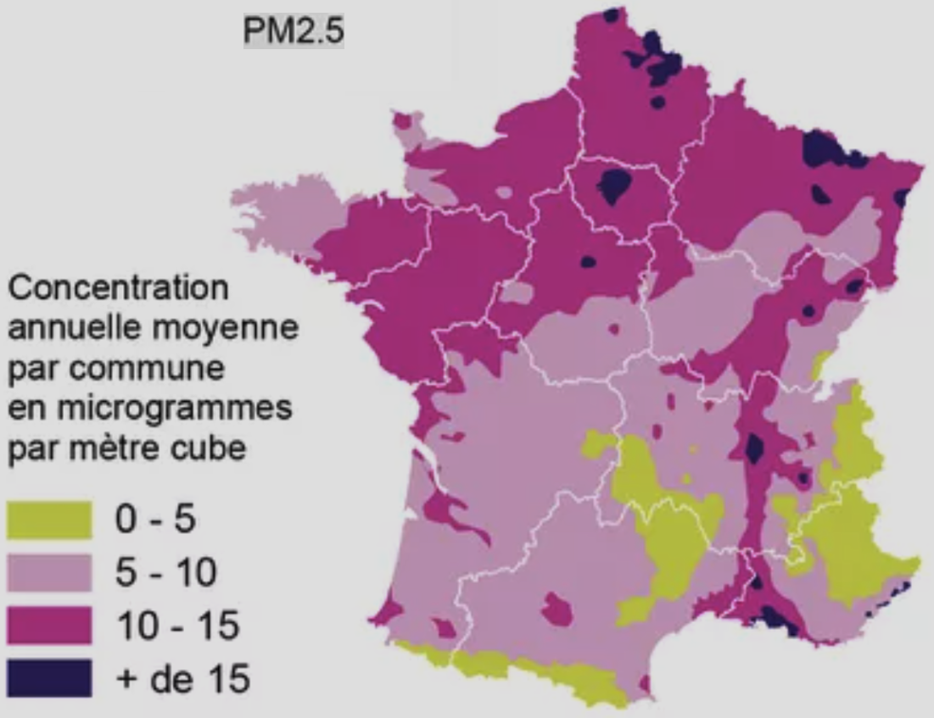
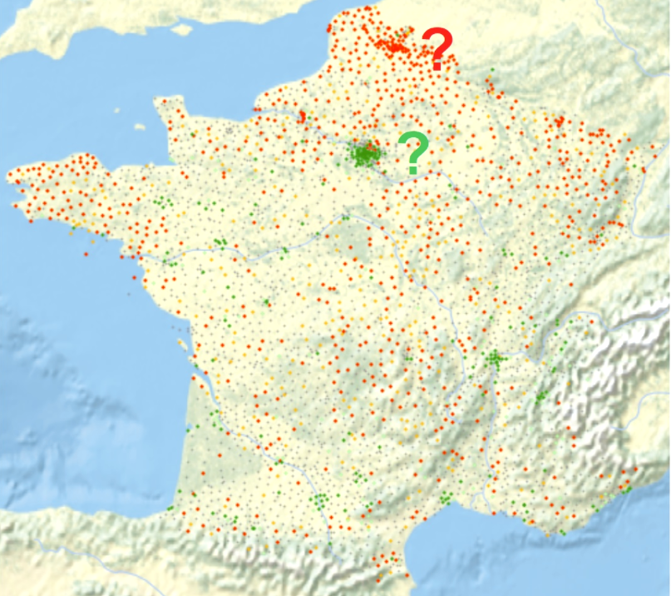


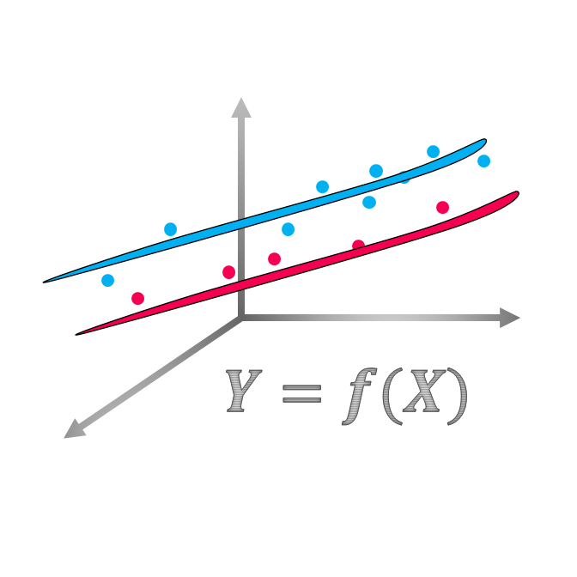
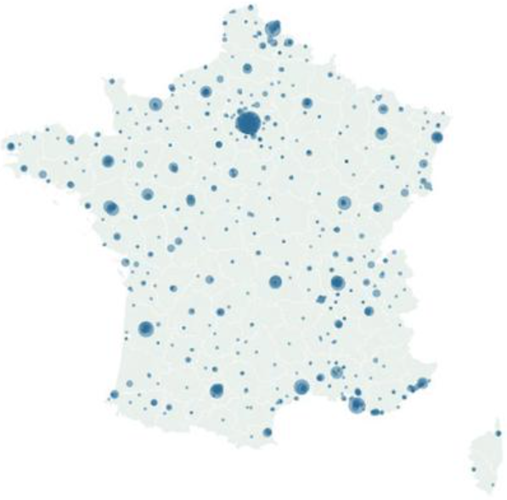
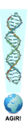

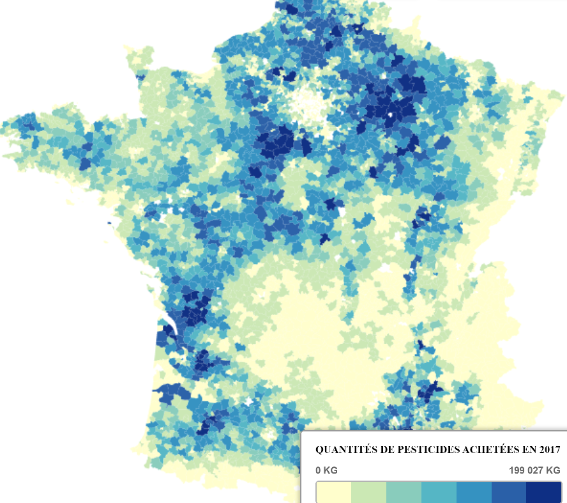
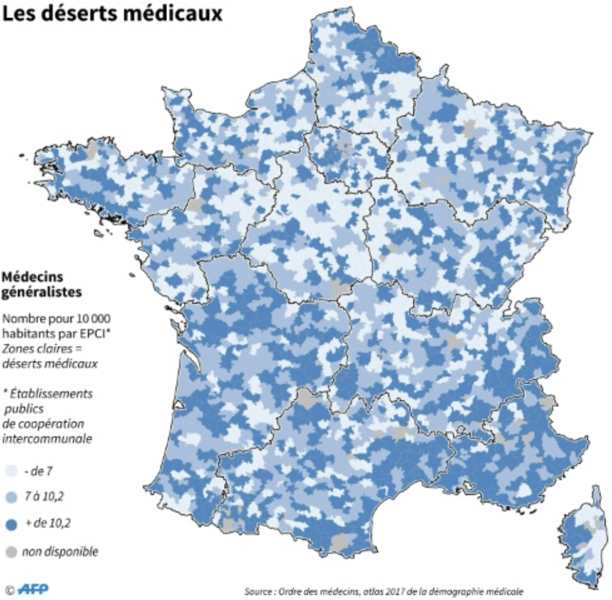

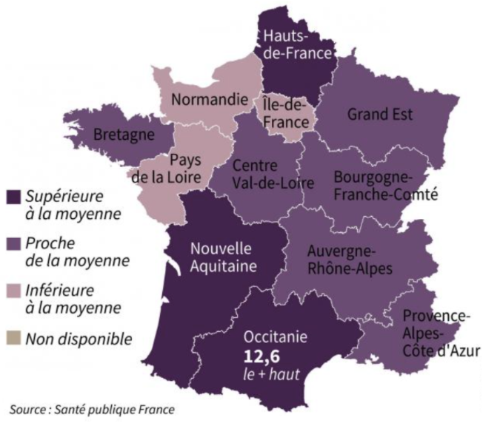
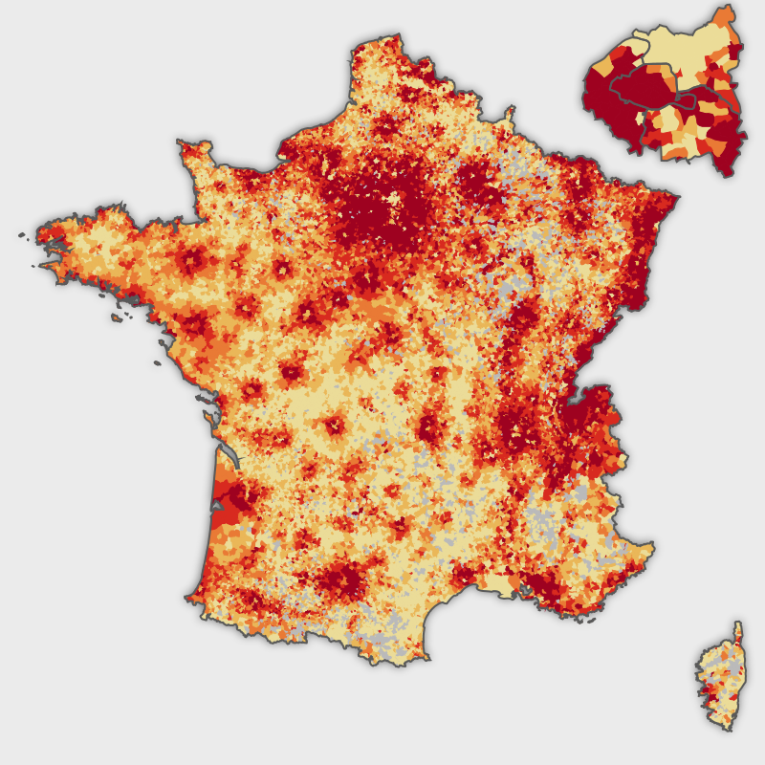
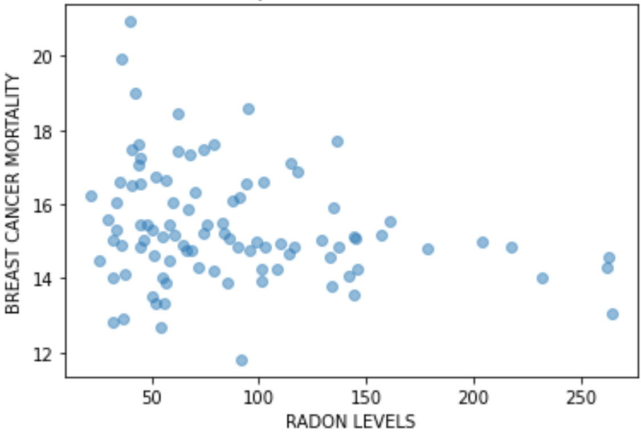
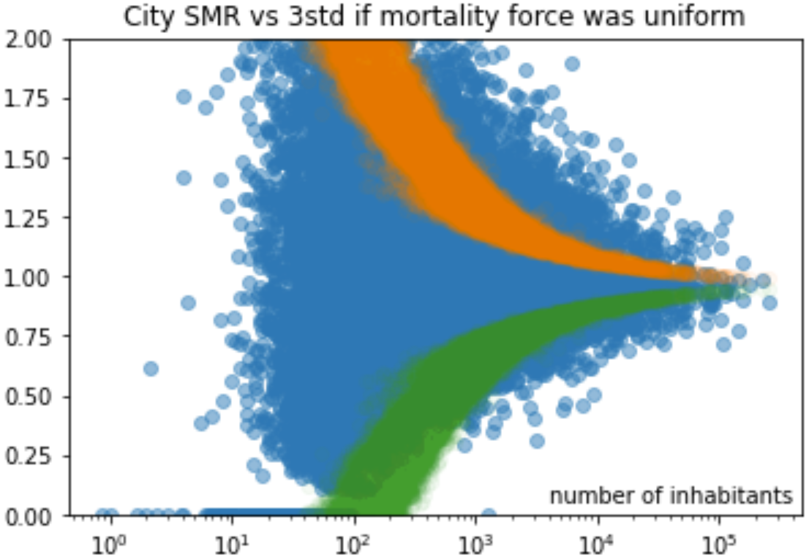
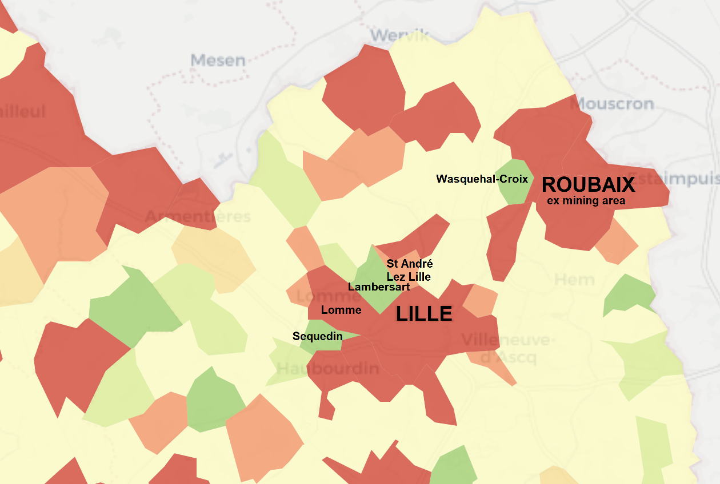
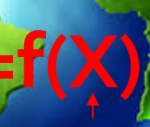
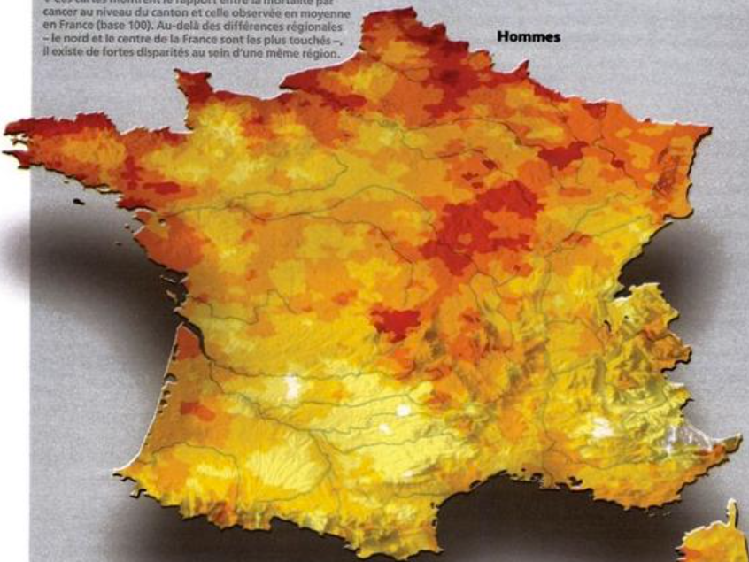

OpenData4Health.org
Lessons from humanity for humanity!
PM 2.5
Following a proof of concept in 2015-2016… a longer term project
smoking
Cancer Baseline
• Deepen the analysis for one country
Cancer risk
arsenic
Y=f(X)
• Build a community
to deepen & enlarge analysis to other countries over time
over
vs ?
under
mortality
cancer
risk/protection factors
pesticides
medical
a) General insight
practice
b) Specific cases
• Highlight issues & solutions and suggest changes
& disease contributions
Epidemium Season 1, 120 volunteers gathering data from different countries and modelling Y=f(X)
HEAlthy Life Extension Society
Reasons to believe
alcohol
Antoine Flahault: Notre santé a besoin d'un atlas et de données publiques
Citizens & authorities together: Des dioxines à Lausanne !
wealth
medical
deserts
Lessons learned so far
Not granular ➔ spurious correlations
Granular ➔ statistics needed
Wealth // behaviors: the case of Lille
NEOS – how to use geographic factors
Mortality of cancers at canton level
& of diseases at department level
https://github.com/Epidemium/EPIDEMIUM-Season-3/OpenData4Health (BSD 2) Edouard Debonneuil, Pol Sans, Ayesha Kawser, Sylvain Sorrin, Pascal Deschaseaux, Sébastien de Longeaux, Adrien Helary, Rachel Aronoff Sources in opendata4health.org

